Slide 1
Invigorate your teaching Jeff Fouts, Director Instructional Technology Peggy Takach, Director Faculty Center for Teaching & Learning

Slide 2
Agenda
1. Welcome
Introductions
2. Getting Started
Workshop description & format
3. Workshop
Engaging strategies
Cool technologies

Slide 3
The Key Ideas
Conclusion
Practice
Reinforce - Teach
Connect
Notes:
Four Key Focus Areas for Windows 10:
Better learning outcomes: technology should help students learn and improve the education process.
Affordable devices and solutions: Microsoft understands the need for a range of devices and solutions to meet the diverse needs of schools around the world.
Safety and security: Institutions require manageable identities and secured devices focused on threat and malware resistance.
Simple to deploy and manage: For 1 classroom or 100, 1 Teacher or 1,000, Windows 10 allows schools to deploy and manage their way.

Slide 4
Connect
Connect learners to topic
Connect learners to outcomes
Connect learners to learners
Notes:
SPEAKER NOTES:
In terms of specific technology solution areas Microsoft’s product development investment ($20Bn) effort is focused in these areas.
(Talk to any specific areas on the slide – focus today is SharePoint, Exchange, Groove, EDRMS, UCC)

Slide 5
Connect
Before or during class
Instant engagement
Connectors
Incentives
Notes:
SPEAKER NOTES:
In terms of specific technology solution areas Microsoft’s product development investment ($20Bn) effort is focused in these areas.
(Talk to any specific areas on the slide – focus today is SharePoint, Exchange, Groove, EDRMS, UCC)

Slide 6
Connect: Activity
Pair Share
Turn to your neighbor
Introduce yourself
State one thing that you hope to learn in workshop
Time = 15 seconds each
1 – 2 pairs share out = 2 minutes

Slide 7
“Teach what is MOST important and reinforce it.”
… what is the need to know
not the want to know…..

Slide 8
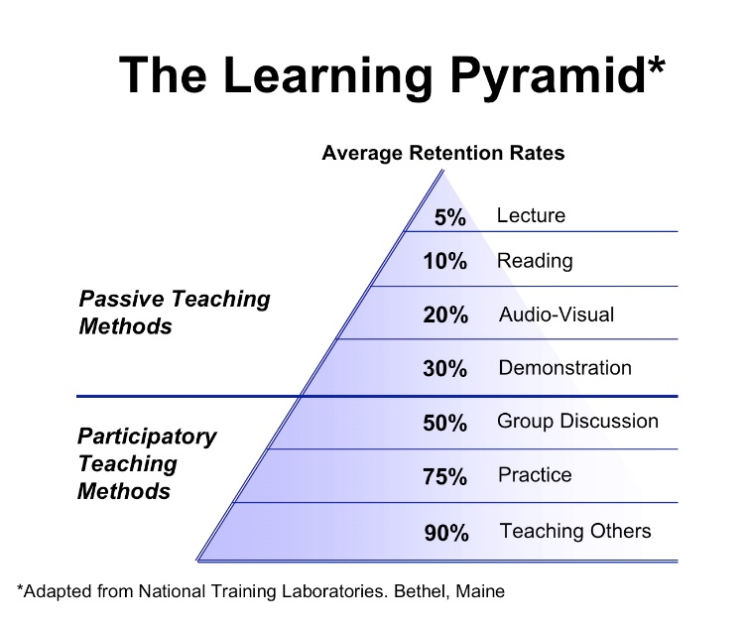
Reinforce - Teaching
http://tuespana.com/wp-content/uploads/2012/06/The-Learning-Pyramid-1.jpg

Slide 9
Reinforce - Teaching: Activity
Snowball Fight
Need a blank sheet paper
Write one “activity” that you currently do to engage students
Snowball fight commences
Total time = 2 minutes

Slide 10
High impact lectures
Interactive lecture strategies

Slide 11
Are your students excited…..
…. engaged?

Slide 12
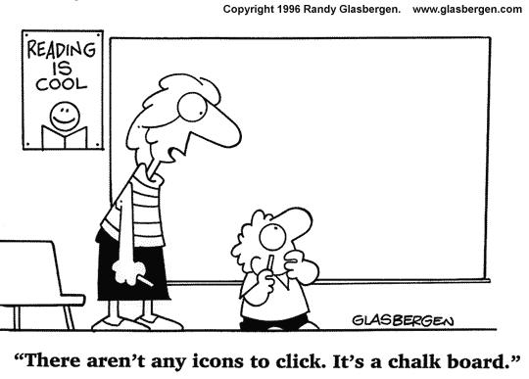
Reinforce - Teaching
Who do you want to be?

Slide 13
“Learners actively practice, review and apply.”
Active participation
Collaborative independence
Individual accountability

Slide 14
Practice: Activity
Pop-up
Everyone stands up to begin
Series of questions will be asked
Stand for “yes”
Sit for “no”
Total time = 30 - 45 seconds

Slide 15
Learners summarize

Slide 16
Learners evaluate what they have learned

Slide 17
Learners make a commitment to apply learning to real life

Slide 18
Conclusion: Activity
Ticket Out
Use index card
Write three things
One strategy that you will apply
Would you be interested in additional workshops?
If yes, please list interested topics

Slide 19
Let’s review:
Invigorate Your Teaching: There is not one strategy that is the best approach…but commit to apply several
5
1
Connect: learners to topic, outcomes and to other learners
2
Reinforce: what they learned that “class”
Conclusion: learners summarize, evaluate what they learned, commit to apply the learning
4
3
Practice: active participation – can be collaborative and individual

Slide 20
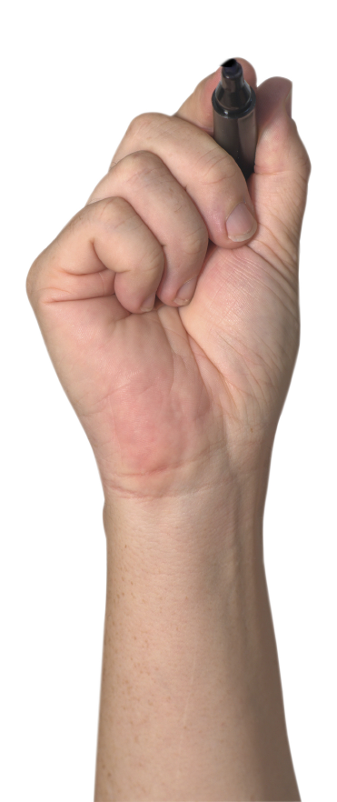
Cool Technologies
Free
Easy
Engaging

