Slide 1

The Culture of Teaching at the iSchool
Art Thomas
Associate Dean for Academic Affairs
Associate Professor of Practice

Slide 2
The iSchool…
A unique blend of:
Information Policy
Information Management
Information Science
Information Technology
…with roots in Library Science, Computer Science, Management Information Systems

Slide 3
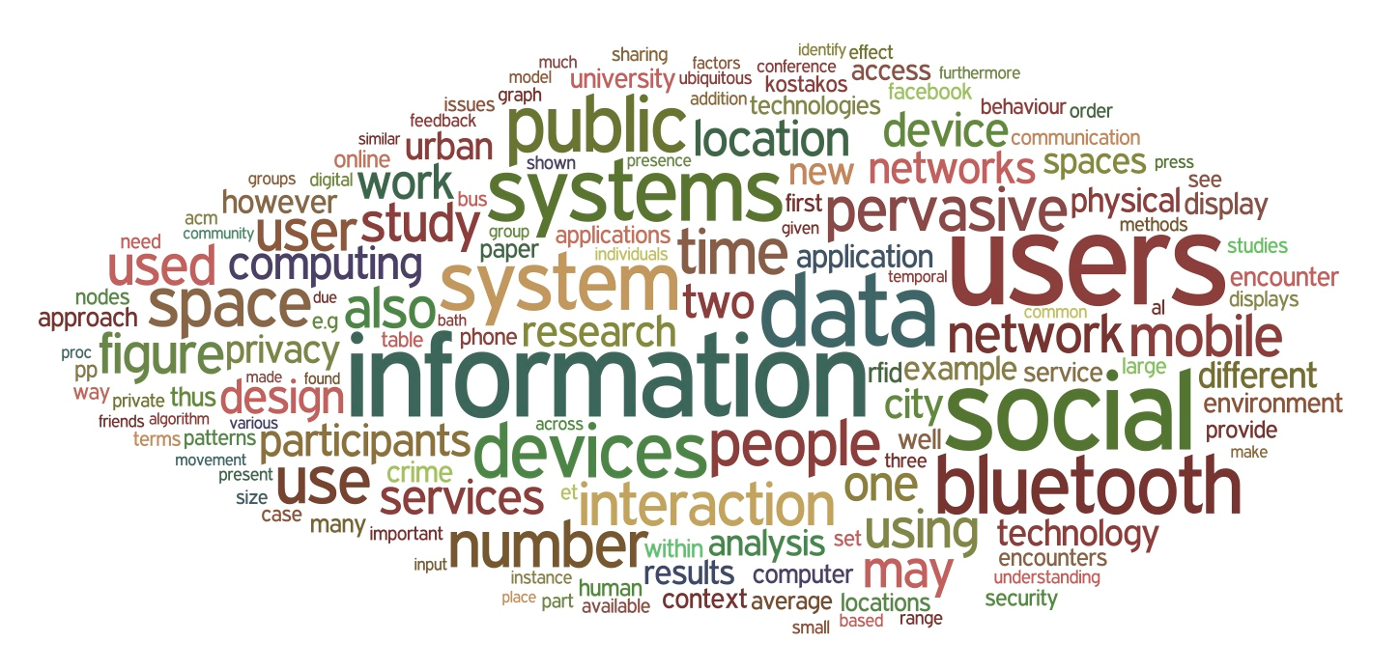
Our Complex World…

Slide 4
Strategic Academic Goal A:
“Our flexible, focused, and state-of-the-art curriculum, together with our innovative teaching, prepares iSchool students for leadership in the information fields.”
iSchool Strategic Plan, 2016

Slide 5
Strategic Academic Goal B:
“All iSchool students bridge the gap between knowing and doing through hands-on, real-world experiences that are
aligned with the vision and goals of the school.”
iSchool Strategic Plan, 2016

Slide 6
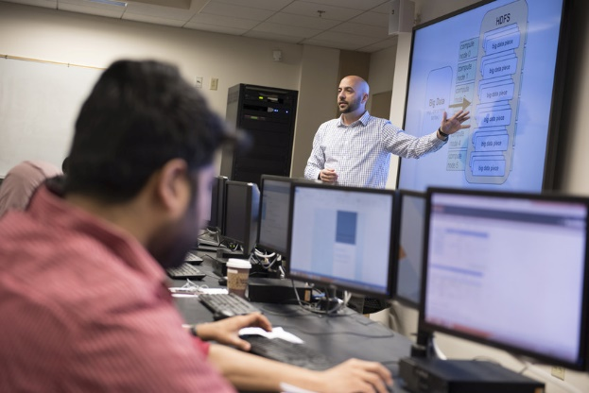
Some facts you should know:
OIRA Course Eval Data, iSchool, 2015-16 Academic Year
8,585
Course Enrollments

Slide 7

Some facts you should know:
OIRA Census Data, iSchool, 2015-16 Academic Year
1,500
Students

Slide 8
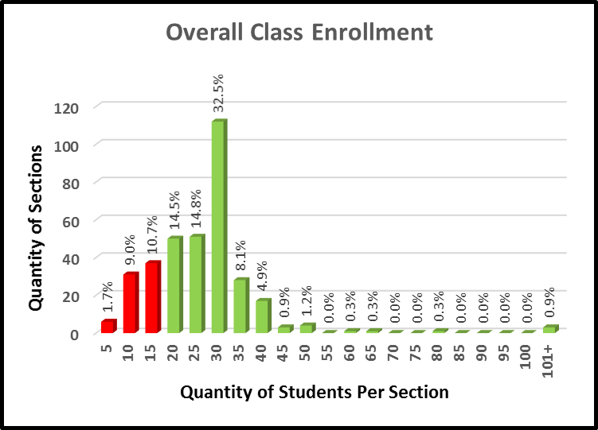

Slide 9

Some facts you should know:
OIRA Course Eval Data, iSchool, 2015-16 Academic Year
343
Course Sections

Slide 10

Some facts you should know:
OIRA Course Eval Data, iSchool, 2015-16 Academic Year
163 (47%)
Sections taught by Full-Time Faculty

Slide 11

Some facts you should know:
OIRA Course Eval Data, iSchool, 2015-16 Academic Year
182 (53%)
Sections taught by Part-Time Faculty

Slide 12
Our Students:
Average about 60/40 Male/Female
Undergraduate – majority domestic
Graduate LIS – majority working domestic
Graduate IM – majority international, with engineering/computer science background

Slide 13
Instructional Adaptations:
Male/Female
International
Engineering Backgrounds
Thoughts on Academic Integrity
  New policies/procedures in Fall
  Make sure students know how to do things right
  Structure of assignments and expectations are key elements

Slide 14
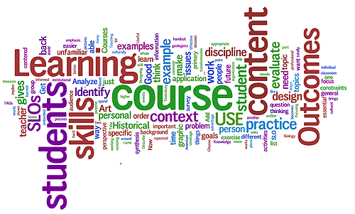

Slide 15
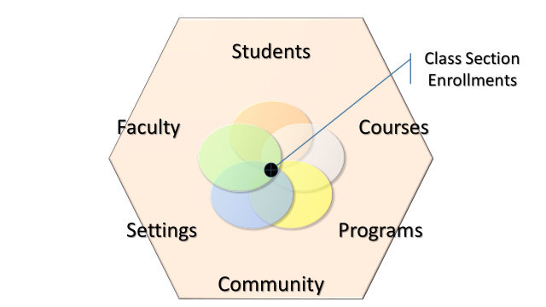
The iSchool’s
Instructional System…

Slide 16
The Curriculum Process:
Employer/Alum Advisories and Input
Program Goals and Evolution
Experimental Topics Classes (Temporary)
Regularization:
  Professor of Record
  Standing Program Committees
  Curriculum Committee
  University Senate Curriculum Committee
  State of New York
Continuous Assessment – Loopback

Slide 17
Evidence of Learning
Evaluation of Academic Performance
Post-Graduation
Outcomes

Slide 18

Continuous Quality…
Instructor Preparation: FCTL
Class Observations
Mid-semester reviews/comments
Final Student Reviews/Evaluations

Slide 19
The Course Evaluation:
Q1: Overall Effectiveness
Q2-4: Course Characteristics
Q5-12: Instructional Interactivity
Q13-15: Evaluation and Progress
Q16-20: Intellectual Component
Q21-24: Group Activities
Q25-29: Open-ended Comments
Special Online Version - Starting Fall 2016

Slide 20
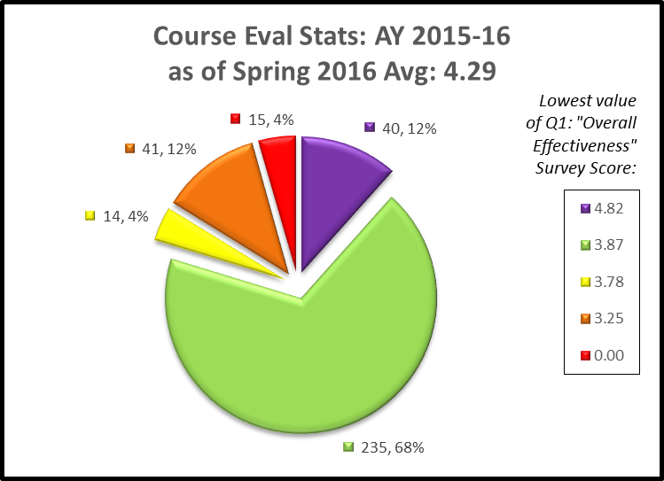
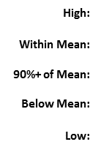

Slide 21
More facts you should know:
OIRA Course Eval Data, iSchool, 2015-16 Academic Year
1.2% (0.06)
Evaluation Score
Range FT - PT

Slide 22
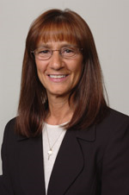
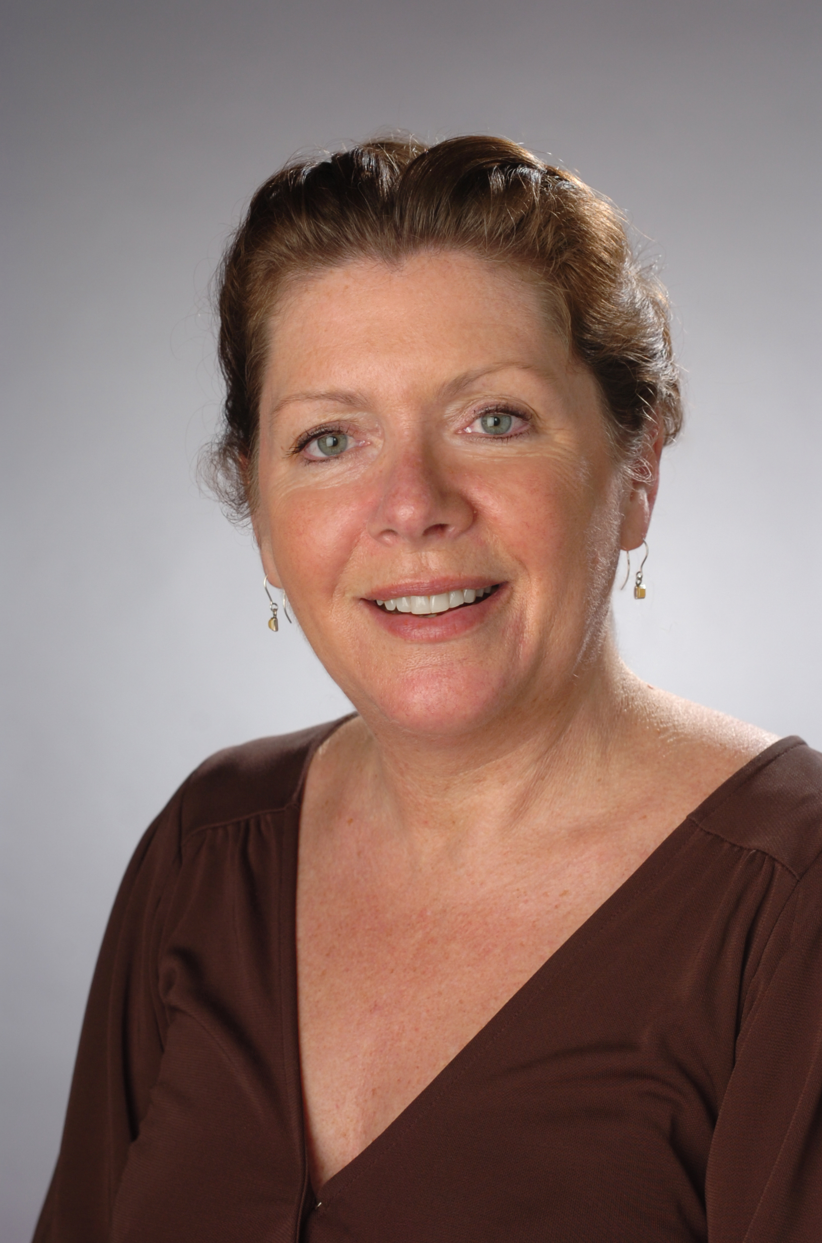

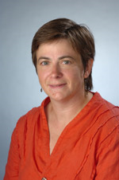

Academic Affairs is here to help!
Roberta Segreti
Assistant
Sheila Clifford-Bova
UGrad Prog Mgr
Dr. Megan Oakleaf
Director of
Instructional
Quality
Lauren McPhillips
IM/TNM Prog Mgr
Blythe Bennett
LIS/SM Prog Mgr

Slide 23

…So, how can we best help YOU??

