Slide 1
Flip a Lesson Plan Peggy Takach, Director Faculty Center for Teaching & Learning

Slide 2
Agenda
Getting Started
Introductions, session description & format
2. Sage on Stage
Background information about Flipping a Lesson Plan
3. Guide on the Side
Learner centered activity with a tour guide

Slide 3
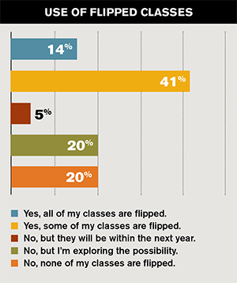
55 Percent of Faculty Are Flipping the Classroom
Campus Technology’s
first-ever Teaching with Technology survey gauged educators' use of the flipped classroom model, blended/online teaching environments and more.
https://campustechnology.com/articles/2016/10/12/55-percent-of-faculty-are-flipping-the-classroom.aspx
Notes:
My name is Barbi Honeycutt, and I’m the founder of Flip It Consulting. I also…

Slide 4
Barbi Honeycutt, PhD
Founder, Flip It Consulting
Flipitconsulting.com
Barbihoneycutt.com
Director of Graduate Teaching and Professional Development Programs, NC State University
Adjunct Assistant Professor, College of Education, NC State University
Notes:
My name is Barbi Honeycutt, and I’m the founder of Flip It Consulting. I also…

Slide 5
F ocus on your
L earners by
I nvolving them in the
P rocess

Slide 6
“Which lesson plan do I flip?”
Look for confusion
Look for fundamentals
Look for boredom
Notes:
Look for confusion – where in the past have students had questions
Look for fundamentals – need to know before moving to next level

Slide 7
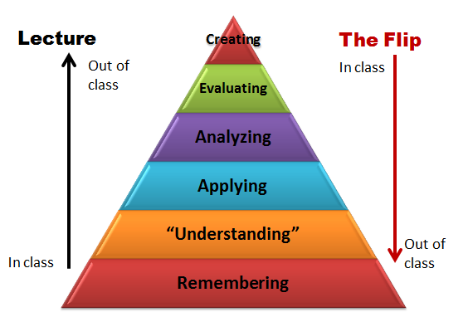
Revised Bloom’s Taxonomy
Notes:
A quick intro to or review of the flipped class model; note how you’re shifting the use of class time from being the delivery of information…

Slide 8
Revised Bloom’s Taxonomy
Notes:
To the focus of higher level thinking skills. Students are engaging in the analysis, synthesis, and creation of information when they are with you in class. Usually students do this type of work outside of class.

Slide 9
Understanding and Remembering
Should be done outside the classroom – before class begins

Slide 10
Applying, Analyzing, Evaluating, Creating
Should be done in class – identify a focus activity to immediately engage

Slide 11
How will class end?
Remember the end of this lesson plan is the beginning of the next plan

Slide 12
“Let’s practice”
Create your own Flipped Lesson Plan
Take out your packets

Slide 13
Brainstorming Worksheet
Create a PPT presentation of at least 5-7 slides describing CRAP principles
Creating
Evaluating
Rank the most common mistakes students make when creating slides
PROCESS
STRATEGY
Compare the use of these principles to other methods of presenting slides
Analyzing
Applying
Use the CRAP principles to create a PPT template
Understanding
Students will be able to describe and apply each of the CRAP principles
Remembering
Identify – students will be able to list the principles to create a PPT slide

Slide 14
Prior to Class
Identify – students will be able to list the principles to create PPT slides
Students describe each of the principles (CRAP) in terms of a visual aid
To achieve outcomes
Watch video on CRAP principles
Review the PPT lecture
Each student find PPT to represent a strong example – post to the blog
Each student find a PPT to represent a weak example – post to the blog

Slide 15
Arrive to Class
Focus activity – first 5 minutes of class
As a team look at each weak PPT – vote on one (focus activity #36 – focus with a vote)
To achieve outcomes
Teams quickly write down notes on how to fix one of the slides from weak PPT
Call on volunteers to present how they would fix based on CRAP principles (focus activity #16 – focus with a student-led presentation and discussion)

Slide 16
During Class
Stay in teams
Rank the most common mistakes students make when creating slides
To achieve outcomes
Working in teams, make a list of mistakes you have fixed or will fix
Place them in CRAP categories
Rank what your team thinks are most common made

Slide 17
End of Class
Focus activity – last 2-5 minutes of class
Student on their own or in teams
To achieve outcomes
Pick one slide and “think outside the box” (focus activity #12 – focus with a challenge)
Re-design to apply “CRAP” principles
Post to team blog

Slide 18
Arrive to Next Class
Focus activity – first 5 minutes of class
Sit in your teams
To achieve outcomes
Based on the blog posts – pick focus activity
Focus activity #21 – focus on a picture
Focus activity #24 – focus with a game (I like using Kahoot)

Slide 19
Connect the flipped strategy to your learning outcome(s)
Provide written and verbal directions, especially for flipped strategies requiring multiple steps
Harness the power of the first five minutes of class. Use a focusing activity
Plan carefully and create structures to stay organized. Use templates, guided notes, table numbers, etc. to organize your materials and manage your time.
Balance individual strategies with group strategies
Balance “active” and “reflective” strategies
Debrief all high energy / high excitement strategies
Recommendations to Consider When You Plan Flipped Strategies

Slide 20
Conclusion: Activity
Ticket Out
Use index card
Write four things
Overall impression of session? Worth time or waste of time?
Would you attend another session held by FCTL?
Topics offered for upcoming sessions?
General comments?

